Slide 1
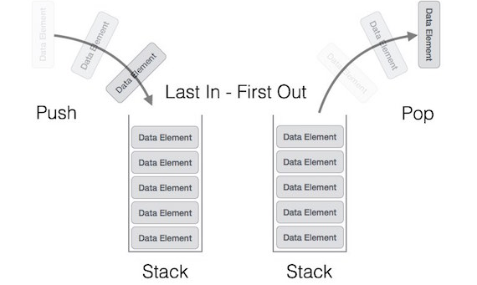
Stack
A stack is an Abstract Data Type (ADT), commonly used in most programming languages.
Basic Operation
PUSH():- Insertion operation.
POP():-Removing Operation.

Slide 2
Stack
peek() − get the top data element of the stack, without removing it.
is Full() − check if stack is full.
is Empty() − check if stack is empty.

Slide 3

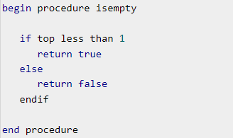
Algorithm
Peek()
is Empty()

Slide 4
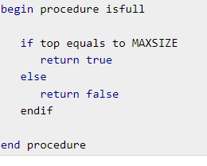
Algorithm
Is Full()

Slide 5
Algorithm
Push()
Step 1 − Checks if the stack is full.
Step 2 − If the stack is full, produces an error and exit.
Step 3 − If the stack is not full, increments top to point next empty space.
Step 4 − Adds data element to the stack location, where top is pointing.
Step 5 − Returns success.

Slide 6
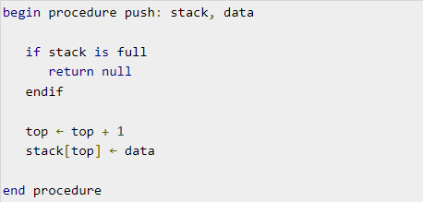
Algorithm
Push()

Slide 7
Algorithm
Pop()
Step 1 − Checks if the stack is empty.
Step 2 − If the stack is empty, produces an error and exit.
Step 3 − If the stack is not empty, accesses the data element at which top is pointing.
Step 4 − Decreases the value of top by 1.
Step 5 − Returns success.

Slide 8
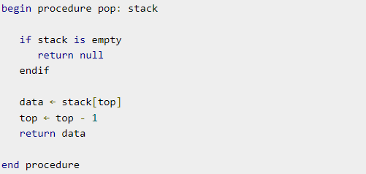
Algorithm
Pop()

Slide 9
Queue
Basic Operation
enqueue() − add (store) an item to the queue.
dequeue() − remove (access) an item from the queue.
peek() − Gets the element at the front of the queue without removing it.
is full() − Checks if the queue is full.
isempty() − Checks if the queue is empty.

Slide 10

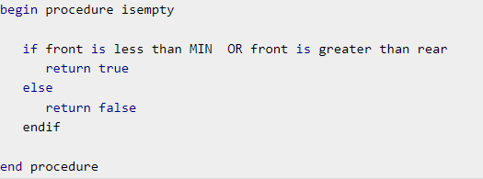
Algorithm
Peek()
is Empty()

Slide 11
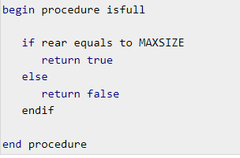
Algorithm
is Full()

Slide 12
Algorithm
Enqueue
Queues maintain two data pointers, front and rear.
Step 1 − Check if the queue is full.
Step 2 − If the queue is full, produce overflow error and exit.
Step 3 − If the queue is not full, increment rear pointer to point the next empty space.
Step 4 − Add data element to the queue location, where the rear is pointing.
Step 5 − return success.

Slide 13
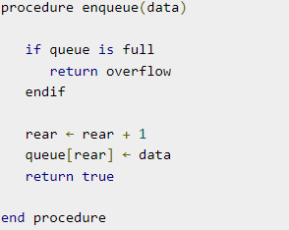
Enqueue

Slide 14
Dequeue
Step 1 − Check if the queue is empty.
Step 2 − If the queue is empty, produce underflow error and exit.
Step 3 − If the queue is not empty, access the data where front is pointing.
Step 4 − Increment front pointer to point to the next available data element.
Step 5 − Return success.

Slide 15
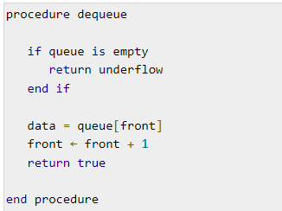
Dequeue

Slide 16
priority queue
A priority queue is a special type of queue in which each element is associated with a priority value.
Basic operation
Poll():-Removing the element.
Add():-insert the element.

Slide 17
Linked list
A linked list is a sequence of data structures, which are connected together via links.
Traversing linked list(forward direction only).
Append the new node(last)
Prepend the new node(add the node to the first)
Deleting the node from the list(Start position).
Deleting the node from the list(specific position).

